Slide 1
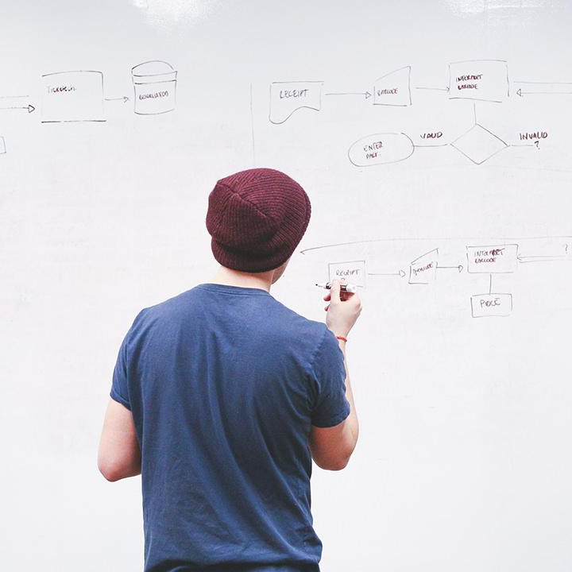
HELLO!
Here 1Crore Projects
I am here because I love to give presentations.
You can find me at @1CROREPROJECTS

Slide 2
Online Music Player

Slide 3

AIM OF PROJECT
The aim of the project is The objective of this project is to design a Music store web application with user interface which will enable them to browse, search, get song recommendations and buy the song-items of their choice
.

Slide 4
ABSTRACT
The objective of this project is to design a Music store web application with user interface which will enable them to browse, search, get song recommendations and buy the song-items of their choice. The motivation of this project comes from my desire to learn the increasingly growing field of SQL server database designing, website designing and their growing popularity by taking up this case study.The word “design” in the context of a Web Application can mean many things. Its most popular usage probably refers to the visual and user interface (UI) design of a web site.

Slide 5
INTRODUCTION
The “Online Music Portal” has been developed to override the problems prevailing in the practicing manual system. This software is supported to eliminate and in some cases reduce the hardships faced by this existing system more over this system is designed for the particular need of the company to carry out operations in a smooth and effective manner.

Slide 6
EXISTING SYSTEM
There were many problems is existing system like to purchase items from shops. I was time consuming, so the user faces many problems.

Slide 7
DISADVANTAGES
Limited customers
The use of manpower in the existing system is so high because maintaining the details about all the products, stock, transaction and much other process.
Quick reports on the current status will be very time consuming and the chances of error will be high.

Slide 8
PROPOSED SYSTEM
The development of this new system contains the following activities, which try to develop on-line application by keeping the entire process in the view of data base integration approach.

Slide 9
ADVANTAGES
Traditional business models are now a thing of the past, and various new opportunities have taken their place in the music industry. This is also the case of popular music streaming platforms, which all have millions of monthly users.
Thanks to these platforms, people can now listen to your music anytime, anywhere, and sometimes for a very small fee. However, you might be wondering, why should I use these platforms if I am an artist? Well, you started reading the right post.

Slide 10


SYSTEM ARCHITECTURE
Signup
Database
Search music
User2
Register
Add Music details
View my playlist
User1

Slide 11
MODULES
In this project has two modules:
User1
User2

Slide 12
User
Only one module:
Login the account with the username and password
View a songs by music directors
User can search the song based on keyword, add the library.
View the songs in that play pause resume, like, new playlist everything will be shown
Logout

Slide 13
HARDWARE REQUIREMENTS
System : Dual core.
Hard Disk : 100 GB.
Floppy Drive : 1.44 Mb.
Monitor : 15 VGA Colour.
Mouse : Logitech Mx Master 3.
Ram :4GB.

Slide 14
SOFTWARE REQUIREMENTS
Operating system : Windows 7/10.
Coding Language : JAVA
Front End : NetBeans Software
Backend : MySQLyog Community 32

Slide 15
FUTURE WORK
At present days every organization is using web technology for their proper functioning, so this web based project is all in all important from market aspects.
Furthermore if this project will be uploaded, it can be used as music entertainment site and any person can register their self on the site to access different type of music alums.

Slide 16
CONCLUSION
The goal of building a simple skeleton application for providing an online music player has been achieved. The idea was to create a simple application to be used as a playground for future ideas of providing valuable music content to the users. Also, a simple algorithm was developed that delivers good playlists with minimal input form the user side. The area used to display track specific information like title, artist, and other.

Slide 17
REFERENCE
1.Lei Gong, Cong Zhou, “Development and Research of Mobile Termination Application Based on Android [J],” Computer and modernization,2008 Yumin 2.Yao,Weiguo Liu, “Study of Android Architecture and Its Application Development,” Computer system application,2008
3. Xianhua Shu, “Mobile Web Map Service Design Based on Android, ” DALIAN MARITIME UNIVERSITY 2009.

Slide 18
THANKS!
Any questions?
You can find me at
Reach us – 1croreprojects@gmail.com
Contact / Whatsapp: 7708 150 152 / 9751 800 789 / 790 432 0834

